Slide 1
Tree

Slide 2
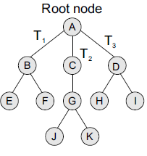
INTRODUCTION
A tree is recursively defined as a set of one or more nodes where one node is designated as the root of the tree and all the remaining nodes can be partitioned into non-empty sets each of which is a sub-tree of the root.
Figure shows a tree where
node A is the root node;
nodes B, C, and D are children of the root node and form sub-trees of the tree rooted at node A.

Slide 3
Tree Terminology
Root: node without parent (A)
Siblings: nodes share the same parent
Internal node: node with at least one child (A, B, C, F)
External node (leaf ): node without children (E, I, J, K, G, H, D)
Ancestors of a node: parent, grandparent, grand-grandparent, etc.
Descendant of a node: child, grandchild, grand-grandchild, etc.
Depth of a node: number of ancestors
Height of a tree: maximum depth of any node (3)
Degree of a node: the number of its children
The leaf of the tree does not have any child so its degree is zero
Degree of a tree: the maximum degree of a node in the tree.
Subtree: tree consisting of a node and its descendants
Empty (Null)-tree: a tree without any node.
Root-tree: a tree with only one node
A
B
C
D
E
F
G
H
I
J
K

Slide 4
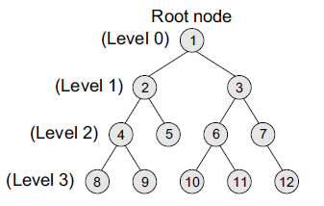
Binary Trees
It is a data structure that is defined as a collection of elements called nodes.
In a binary tree,
the topmost element is called the root node, and
Each node has 0, 1, or at the most 2 children.
A node that has zero children is called a leaf node or a terminal node.
Every node contains a data element, a left pointer which points to the left child, and a right pointer which points to the right child.

Slide 5
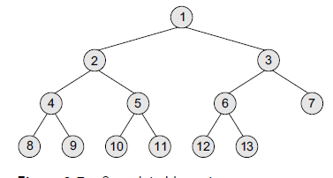
Complete Binary Trees
A complete binary tree is a binary tree that satisfies two properties.
First, in a complete binary tree, every level, except possibly the last, is completely filled.
Second, all nodes appear as far left as possible.

Slide 6
Representation of Binary Trees in the Memory
Linked representation of binary trees
In the linked representation, every node will have three parts:
the data element, a pointer to the left node, and a pointer to the right node.
So in C++, the binary tree is built with a node type given below.
class node {
struct node *left;
int data;
struct node *right;
};
Every binary tree has a pointer ROOT, which points to the root element (topmost element) of the tree. If ROOT = NULL, then the tree is empty.

Slide 7
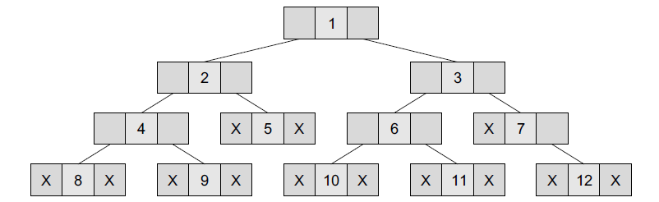
Linked representation of binary trees

Slide 8
Sequential representation of binary tree
Sequential representation of trees is done using single or one-dimensional arrays. Though it is the simplest technique for memory representation, it is inefficient as it requires a lot of memory space.
A sequential binary tree follows the following rules:
A one-dimensional array, called TREE, is used to store the elements of tree.
The root of the tree will be stored in the first location. That is, TREE[1] will store the data of the root element.
The children of a node stored in location K will be stored in locations (2 × K) and (2 × K+1).
The maximum size of the array TREE is given as (2^{h+1}–1), where h is the height of the tree.
An empty tree or sub-tree is specified using NULL. If TREE[1] = NULL, then the tree is empty.

Slide 9
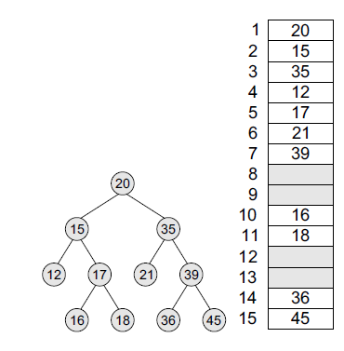
Array Implementation of a binary tree
For any node k
The left child of a node K = 2 × K
The right child of a node K = 2 × K+1
Parent of any node K = floor (K/2)

Slide 10
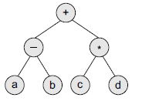
Expression Tree
Binary trees are widely used to store algebraic expressions.
For example, consider the algebraic expression given as:
Exp = (a – b) + (c * d)

Slide 11
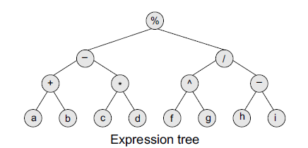
Given an expression, Exp = ((a + b) – (c * d)) % ((f ^g) / (h – i)), construct the corresponding binary tree.

